Slide 1



EFFECTS OF FIXED AND VARIABLE DAMPING ENVIRONMENTS ON ANKLE AGILITY AND STABILITY
Harrison Hanzlick
Dr. Hyunglae Lee
ASU/NASA Space Grant
4/14/2018

Slide 2



Importance of the Ankle
Ankle is the primary joint responsible for transferring energy between the lower extremity (leg) and the environment.
Postural maintenance (standing).
Locomotion (walking).
Reacting to sudden changes in environment (balance).
Proper control of ankle is vital to maintaining stability of the lower extremity.
Postural maintenance
Locomotion

Slide 3

Overview
Use robotic systems to characterize the natural properties of the human ankle.
Use robotic systems to augment and enhance the natural properties of the human ankle.
This Study:
Quantified ankle agility/stability trade off across a range of damping-defined environmental conditions.

Slide 4
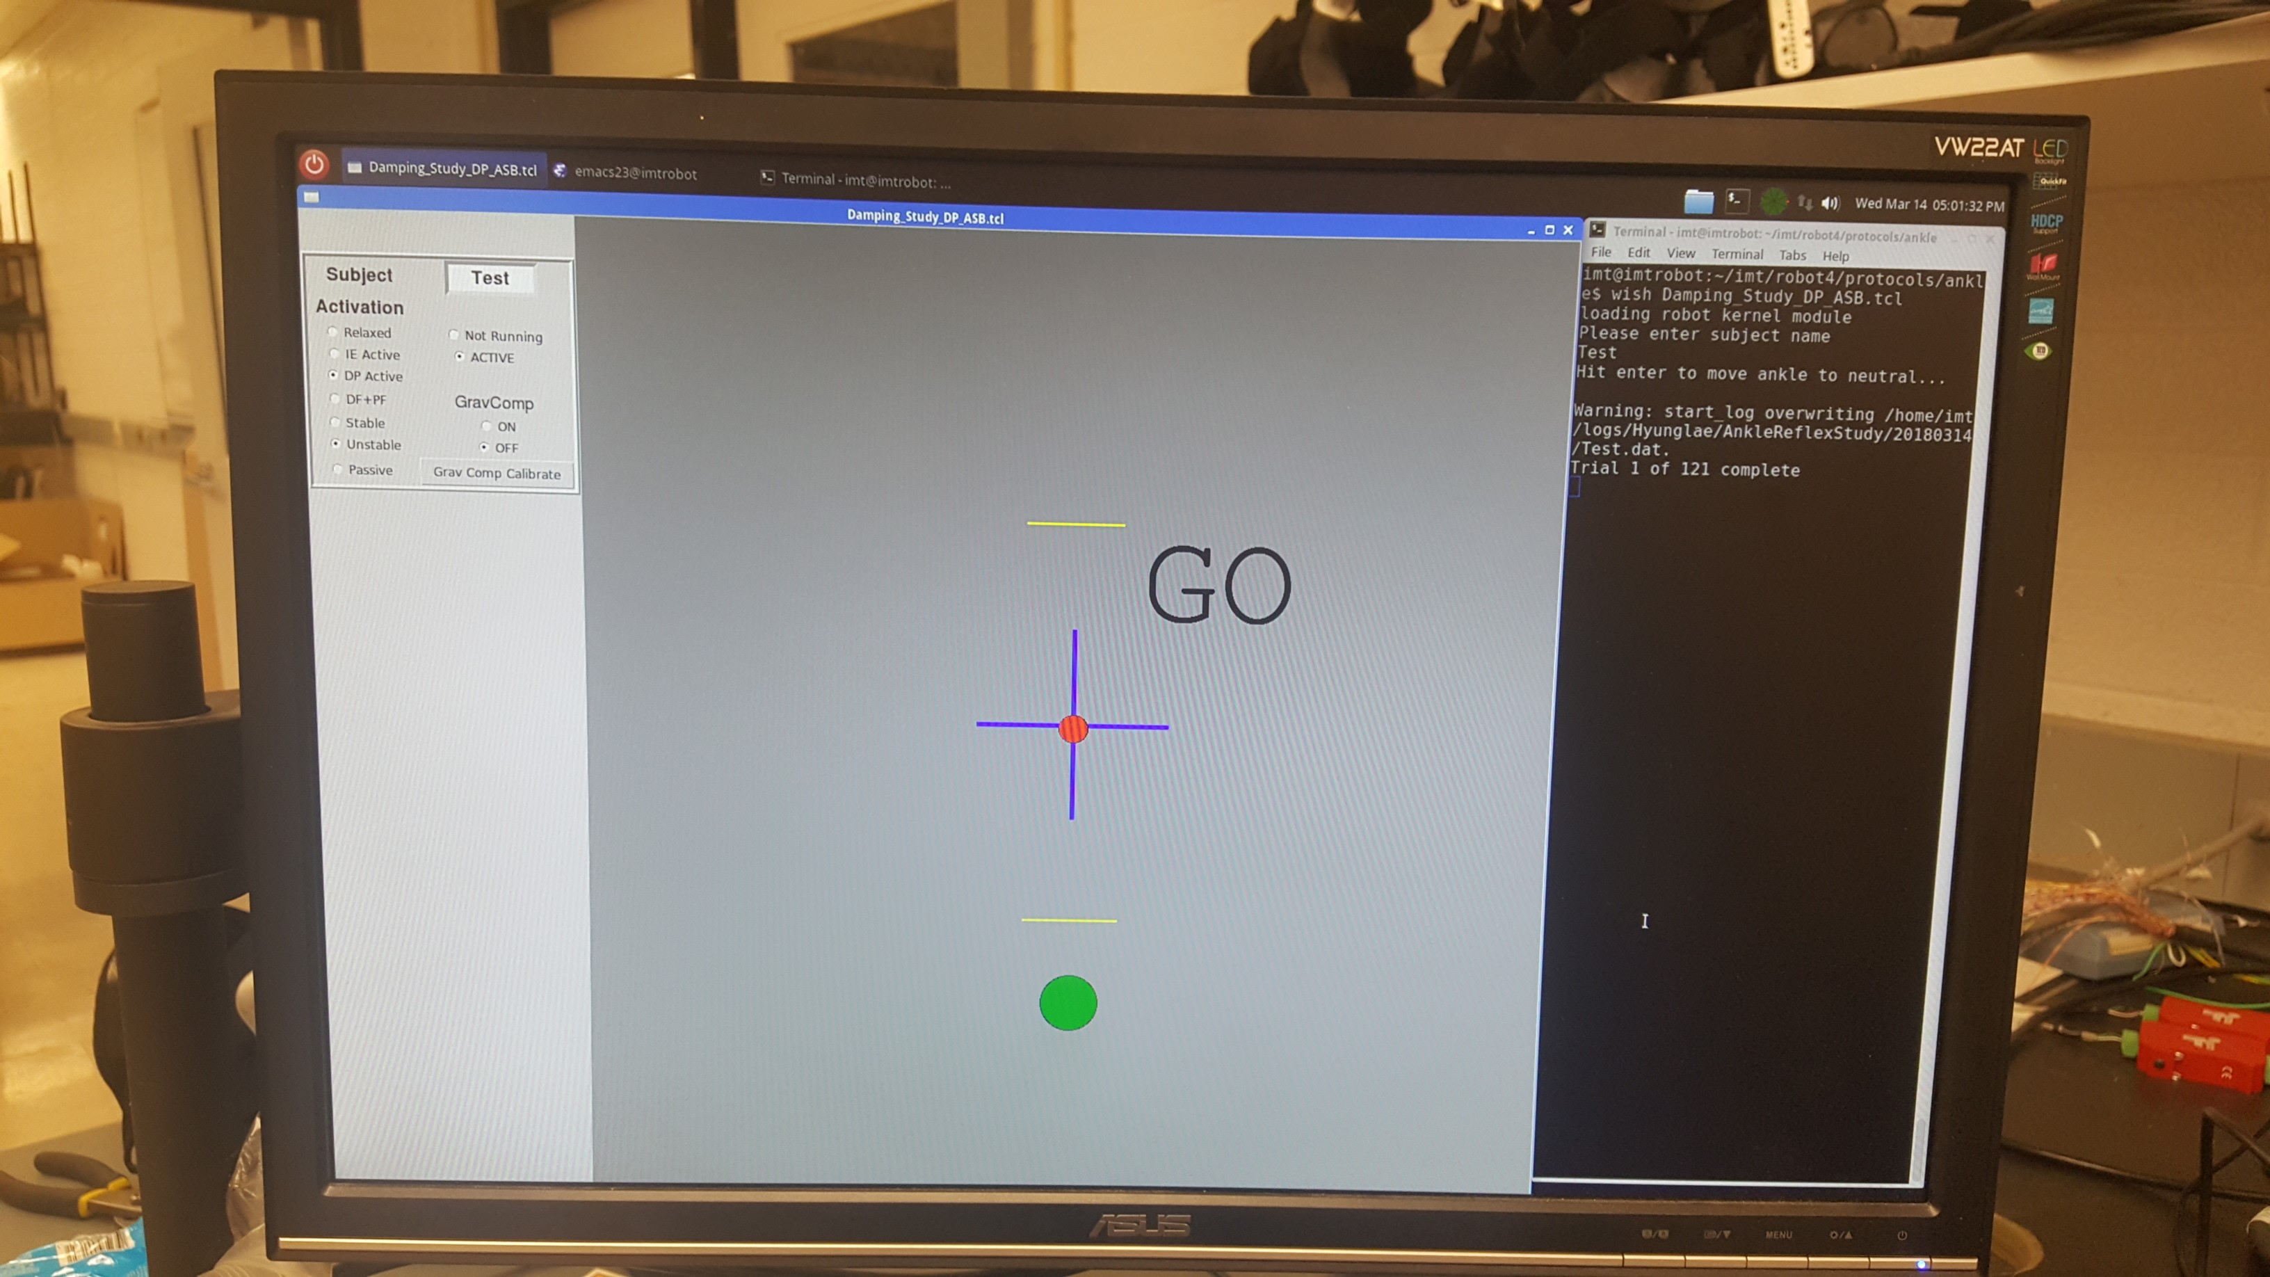
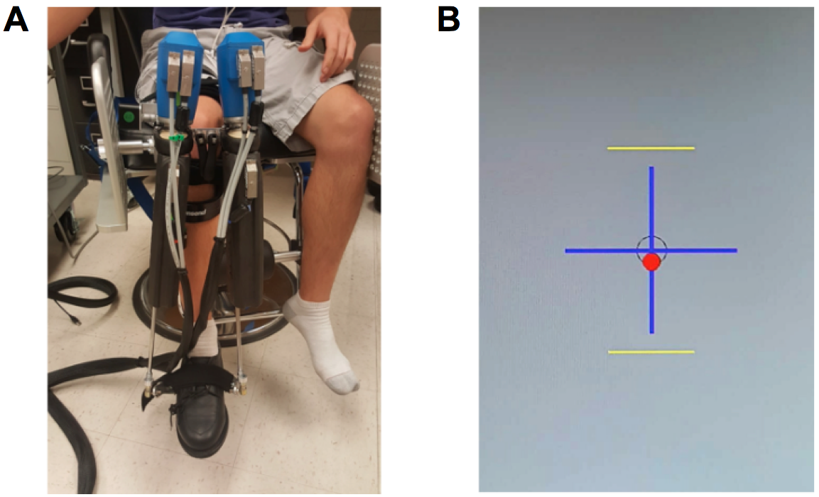
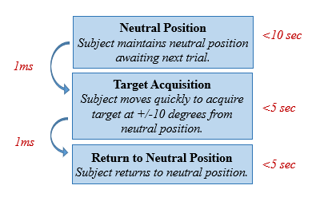
Experimental Setup
Damping = [-1.0, 0.0, +1.0] Nm*sec/rad

Slide 5
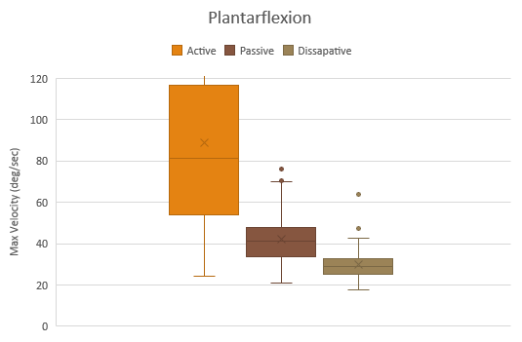
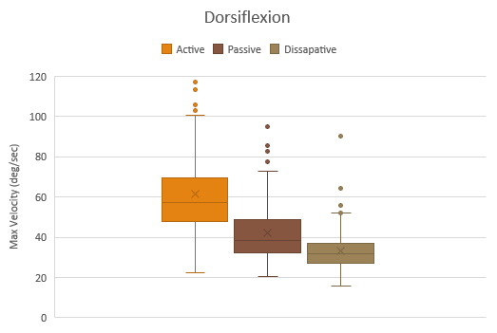
Agility Aggregate Results

Slide 6
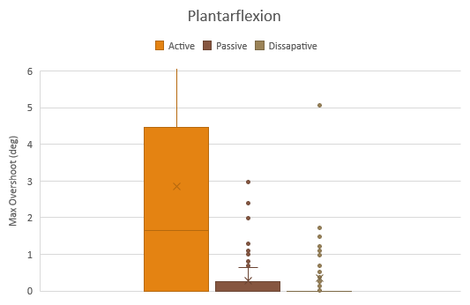
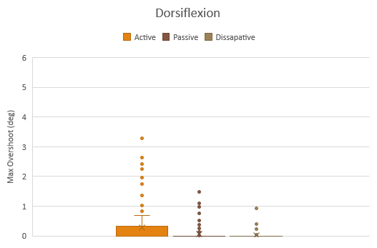
Stability Aggregate Results

Slide 7
Takeaway?
Negative damping increases agility but decreases stability.
Positive damping decreases agility but increases stability.
There is a trade-off, but can we have the best of both?
Variable damping environments.

Slide 8
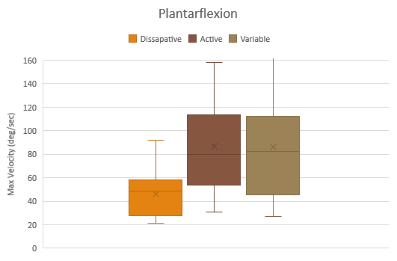
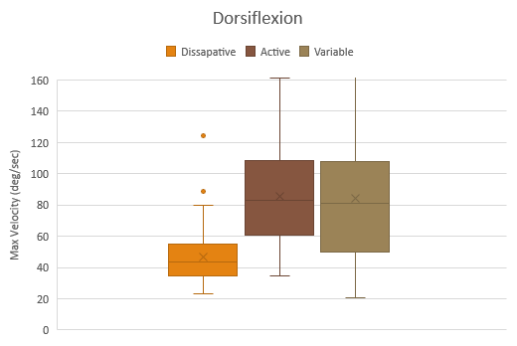
Agility Aggregate Results

Slide 9
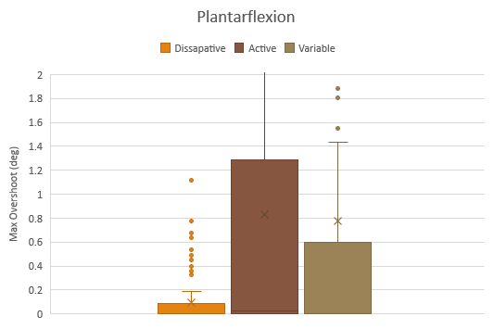
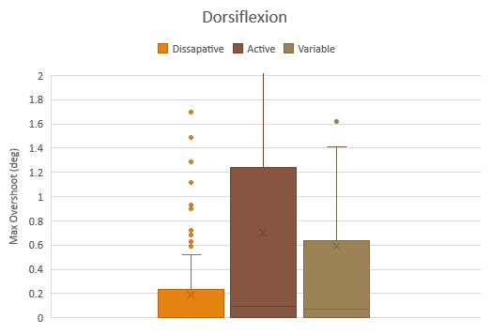
Stability Aggregate Results

Slide 10
Conclusions
Constant damping environments offer either enhanced agility or stability.
Variable damping environment offers most of the agility boost of negative damping without as much instability.
Variable damping shows potential as a control scheme for assistive devices—several factors must be tuned for each individual.

Slide 11
Acknowledgments
Dr. Hyunglae Lee
ASU/NASA Space Grant
Dr. Thomas Sharp and Ms. Desiree Crawl

Slide 12
Thank you

